Slide 1





DELHI PUBLIC SCHOOL AGRA
(Under the aegis of The Delhi Public School Society, East of Kailash, New Delhi)
2020
CBSE
GRADE-XII
RESULT
100%
21
THE BEST WAY TO PREDICT YOUR FUTURE
IS TO CREATE IT. YOU HAVE CREATED A GREATER ONE.
BEST WISHES ON YOUR ACHIEVEMENT!!!

Slide 2




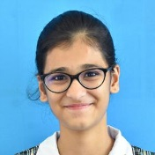
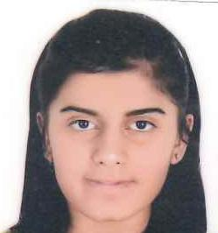

DELHI PUBLIC SCHOOL AGRA
GRADE-XII
2021
(Under the aegis of The Delhi Public School Society, East of Kailash, New Delhi)
AISSCE TOPPERS - 2021
HUMANITIES TOPPER
SCIENCE TOPPER
COMMERCE TOPPER
99.4%
DEV ISHAAN AGARWAL
98.4% ADHYAN BALUJA
97.6%
ASHI
JAIN
97.6% KHUSHI TALWAR
MAJOR ACHIEVEMENTS
1. 265 STUDENTS OUT OF 275 - i.e. 96.36 % SECURED DISTINCTIONS AND ABOVE IN OVERALL PERCENTAGE. 2. TOTAL DISTINCTIONS IN INDIVIDUAL SUBJECTS–1282 3. 90% AND ABOVE - 123 STUDENTS 4. A1 IN ALL 5 COMPULSORY SUBJECTS - 16 STUDENTS 5. SCHOOL AVERAGE – 87.73 %
STREAM WISE PERFORMANCE
STREAM | TOTAL STUDENTS | 90% AND ABOVE | 75% - 90% | 60% - 75%
SCIENCE | 93 | 42 | 50 | 1
COMMERCE | 127 | 46 | 73 | 8
HUMANITIES | 55 | 35 | 19 | 1

Slide 3
DELHI PUBLIC SCHOOL AGRA
GRADE-XII
2021
(Under the aegis of The Delhi Public School Society, East of Kailash, New Delhi)
SUBJECT | MARKS | STUDENT NAME
ECONOMICS | 100 | Dev Ishaan Agarwal
HISTORY | 100 | Dev Ishaan Agarwal
MATHS | 100 | Dev Ishaan Agarwal
PAINTING | 100 | Rishin Khandelwal, Vishakha
PHYSICAL EDUCATION | 100 | Milind Shekhar Singh
ACCOUNTS | 99 | Riddhi Jain, Samrat Krishna Arora
BIOLOGY | 99 | Saadgi Chaturvedi, Siya Jolly, Anisha Agarwal
BIOTECH | 99 | Isha Luthra
BUSINESS STUDIES | 99 | Samrat Krishna Arora, Ashi Jain, Navya Sachdeva, Kashish Garg, Krati Agarwal, Khushi Talwar, Yashika Singh, Kshitiz Krishna Goyal
CHEMISTRY | 99 | Dhritee Bakshi, Nirjhara Kaushik
COMPUTER SCIENCE | 99 | Mehul Kasliwal
ENGLISH | 99 | Tejaswani Saini, Adhyan Baluja, Yukti Arora
ENTREPRENEURSHIP | 99 | Yashika Singh
GEOGRAPHY | 99 | Ronit Kumar Singh, Anshika Yadav
PHYSICS | 99 | Divyansh Jain, Arpit Garg
POLITICAL SCIENCE | 99 | Dev Ishaan Agarwal, Tejaswani Saini, Ishita, Milind Shekhar Singh, Yashovardhan Vashishtha, Diaa Bansal
LEGAL STUDIES | 98 | Avi Kapoor, Tanmay Doneria, Sanaah Mehra
PSYCHOLOGY | 98 | Tejaswani Saini, Ishita
SUBJECT TOPPERS

Slide 4


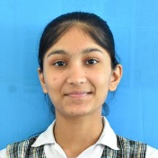



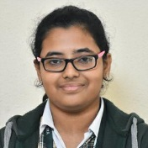
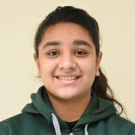

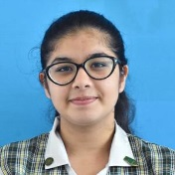


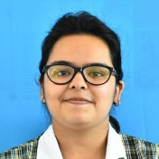
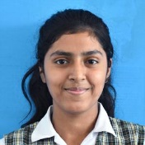
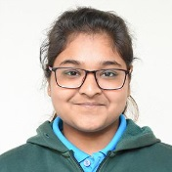

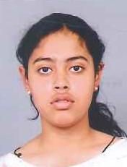
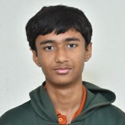
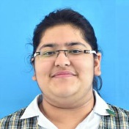

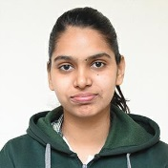
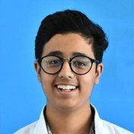
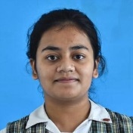
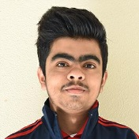
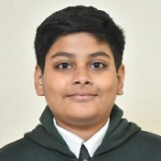
DELHI PUBLIC SCHOOL AGRA
GRADE-XII
2021
(Under the aegis of The Delhi Public School Society, East of Kailash, New Delhi)
TOP STUDENTS SECURING 90% AND ABOVE
99.4%
DEV ISHAAN AGARWAL (HUMANITIES)
98.8% TEJASWANI SAINI (HUMANITIES)
98.4% ADHYAN BALUJA (SCIENCE)
98.4% MILIND SHEKHAR SINGH (HUMANITIES)
97.6%
ARPIT GARG (SCIENCE)
97.6%
ASHI JAIN (COMMERCE)
97.6% KHUSHI TALWAR (COMMERCE)
97.6%
AVI KAPOOR (HUMANITIES)
97.6%
ISHITA (HUMANITIES)
97.4%DHRITEE BAKSHI (SCIENCE)
97.4% YOGASHISH SARIN (SCIENCE)
97.4%
RIDDHI JAIN (COMMERCE)
97.2% HIMANSHU GUPTA (SCIENCE)
97%
DIVYANSH JAIN (SCIENCE)
97%
ISHA LUTHRA (SCIENCE)
96.8% NIRJHARA KAUSHIK (SCIENCE)
96.8% KASHISH GARG (COMMERCE)
96.8% SAMRAT KRISHNA ARORA (COMMERCE)
96.8% YASHIKA SINGH (COMMERCE)
96.6% MEHUL KASLIWAL (SCIENCE)
96.6%
SIYA JOLLY (SCIENCE)
96.6% YASHOVARDHAN VASHISTHA (HUMANITIES)
96.4% ANSHIKA YADAV (HUMANITIES)
96% NAVYA SACHDEVA (COMMERCE)
96%
ANIKA DAS (HUMANITIES)
95.8%
DHRUV CHOPRA (SCIENCE)
95.8%
ISHAN ARORA (SCIENCE)

Slide 5
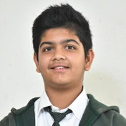
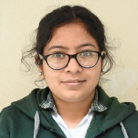
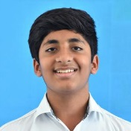
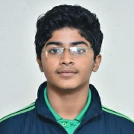
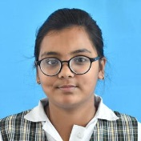
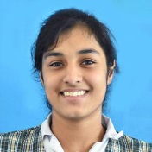

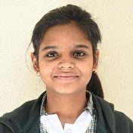
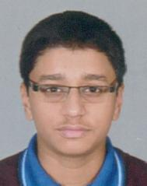

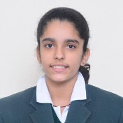
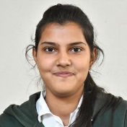



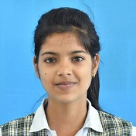
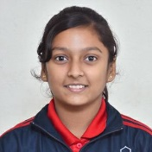

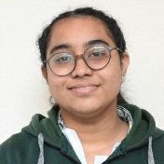
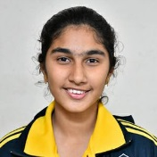
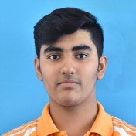
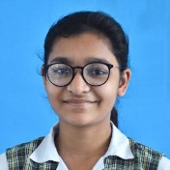
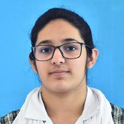
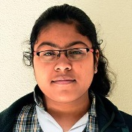

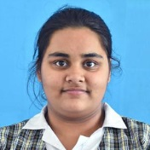
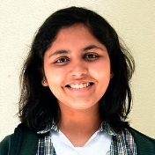
DELHI PUBLIC SCHOOL AGRA
GRADE-XII
2021
(Under the aegis of The Delhi Public School Society, East of Kailash, New Delhi)
TOP STUDENTS SECURING 90% AND ABOVE
95.8% ARUNAV AGARWAL (SCIENCE)
95.8% GUNISHTHA DOOMRA (SCIENCE)
95.8% SHASHWAT MISRA (COMMERCE)
95.8% KUSHAGRA JAIN (COMMERCE)
95.8%
MANU YADAV (HUMANITIES)
95.8%
DIAA BANSAL (HUMANITIES)
95.8%
SHIVAM (HUMANITIES)
95.6% BHUMIKA SINGH (SCIENCE)
95.6%
PARTH SARIN (SCIENCE)
95.6% HARSH MEROTHIYA (COMMERCE)
95.6% SANAAH MEHRA (HUMANITIES)
95.6% SIYA CHAUDHARY (HUMANITIES)
95.6% TANMAY DONERIA (HUMANITIES)
95.4%
AMBER TOMAR (SCIENCE)
95.4% DHRUV KHANDELWAL (SCIENCE)
95.4%ANISHA AGARWAL (SCIENCE)
95.4% DEEPANSHI AGARWAL (COMMERCE)
95.4% ANSH PANJWANI (COMMERCE)
95.4%
SIRJAN KAUR (HUMANITIES)
95.2% SAADGI CHATURVEDI (SCIENCE)
95.2% RISHIN KHANDELWAL (SCIENCE)
95.2% KRATI AGARWAL (COMMERCE)
95%
AAMNA IKRAM (SCIENCE)
95% TANISHKA SINGH
(SCIENCE)
95%
ANANT JAIN (COMMERCE)
94.6% DIVYANSHI JAIN (COMMERCE)
94.4% SAUMYA TRIPATHI (SCIENCE)

Slide 6
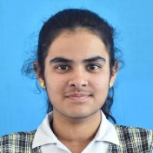
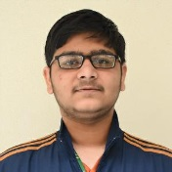
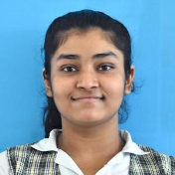
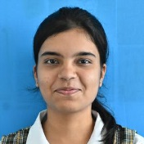
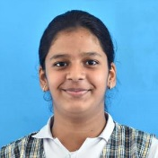
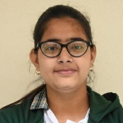
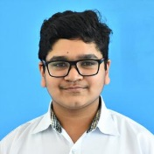
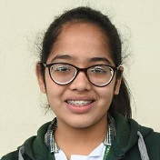


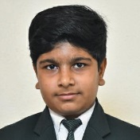
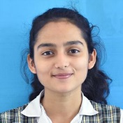

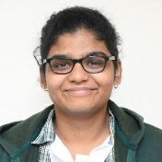


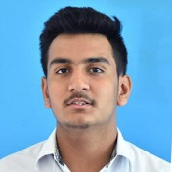
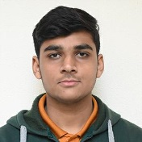









DELHI PUBLIC SCHOOL AGRA
GRADE-XII
2021
(Under the aegis of The Delhi Public School Society, East of Kailash, New Delhi)
TOP STUDENTS SECURING 90% AND ABOVE
94.4%DIVYA GHATWANI (SCIENCE)
94.2% SUVRAT AGARWAAL (SCIENCE)
94.2% JESSICA AGARWAL (COMMERCE)
94.2% KIRTI GIYAMALANI (COMMERCE)
94.2% ASHWINA CHAUDHARY (HUMANITIES)
94.2% RAJASHWI SAXENA (HUMANITIES)
94% RAGHAV BAGLA (SCIENCE)
94% MEDHA DANI (COMMERCE)
93.8% RAJVARDHAN SINGH (SCIENCE)
93.6% NIKHIL SABHARWAL (SCIENCE)
93.4% SHARDUL CHARAG (SCIENCE)
93.4% VRISHBHANVI SINGH (COMMERCE)
93.4% BHAUMIK SHAKYA (HUMANITIES)
93.4%
HARINI SATISH (HUMANITIES)
93.4%
PULKIT SINGH (COMMERCE)
93% JAIVARDHAN SINGH (SCIENCE)
93% PULKIT KHURANA (HUMANITIES)
93% RONIT KUMAR SINGH (HUMANITIES)
92.8%
SAHIL JAIN (COMMERCE)
92.8% HIMANSHU AGARWAL (COMMERCE)
92.6% ANSH MEHANDIRATTA (COMMERCE)
92.6% PRAB JOT KAUR (COMMERCE)
92.6% RAGHAV BANSAL (COMMERCE)
92.6% SAJAL BANSAL (COMMERCE)
92.4%
SPARSH JAIN (COMMERCE)
92.4%
KAVYA DIXIT (HUMANITIES)
92.4% RITIKA KHANDELWAL (HUMANITIES)

Slide 7



























DELHI PUBLIC SCHOOL AGRA
GRADE-XII
2021
(Under the aegis of The Delhi Public School Society, East of Kailash, New Delhi)
TOP STUDENTS SECURING 90% AND ABOVE
92.4% SANSKRITI SINGH (HUMANITIES)
92.2% KHUSHI YADAV (HUMANITIES)
92% VRITI PARASWANI (COMMERCE)
92% TANISHA AGARWAL (COMMERCE)
91.8%
CHARVI THAPAR (COMMERCE)
91.8% ISHITA AGARWAL (HUMANITIES)
91.6%
YUKTI ARORA (SCIENCE)
91.6% PANDIRI NEETHU PRIYA (SCIENCE)
91.6% HARSH AGARWAL (COMMERCE)
91.4%
CHIRAG GARG (COMMERCE)
91.4% JHALAK CHAUDHARY (HUMANITIES)
91.4%
MANAV BAREJA (COMMERCE)
91.2%ARYAN SINGHAL (HUMANITIES)
91.2% NAMAN PANICKER (SCIENCE)
91%
ANK AGARWAL (SCIENCE)
91% ARPITA HOTCHANDANI (COMMERCE)
91%
KIRTI JAIN (COMMERCE)
91% SAUMYA TOMAR (COMMERCE)
91%
KHUSHI JAIN (COMMERCE)
91% SABHYA SHARMA (COMMERCE)
91% ASHWANI BHOJWANI (COMMERCE)
91% AMAN BIR SINGH SAWHNEY (COMMERCE)
91% JIGISHA AGRAWAL (COMMERCE)
91% YOSHITA SINGH (HUMANITIES)
90.6% TANYA BHARDWAJ (SCIENCE)
90.6%ADITYA DONERIA (SCIENCE)
90.6% NEHAL AGARWAL (COMMERCE)

Slide 8















DELHI PUBLIC SCHOOL AGRA
GRADE-XII
2021
(Under the aegis of The Delhi Public School Society, East of Kailash, New Delhi)
TOP STUDENTS SECURING 90% AND ABOVE
90.4% DIVYAANSHU AGRAWAL (SCIENCE)
90.6%
PALAK TIWARI (HUMANITIES)
90.4%
UDBHAV (HUMANITIES)
90.2% DHRUV AGARWAL (SCIENCE)
90% NAYONIKA SAHA
(SCIENCE)
90% ADITYA KRISHN BANSAL (COMMERCE)
90% SHREYASI VERMA (HUMANITIES)
90% SWEETY CHAHAR (HUMANITIES)
89.8% NITIN VISHAL SINGH (SCIENCE)
89.8% KARAN AGARWAL (SCIENCE)
89.8% SUBHIKA LUTHRA (COMMERCE)
89.8% PAWANI ASWANI (HUMANITIES)
89.6%
VIVEK MANGAL (COMMERCE)
89.6% AKSHARA JAIN (COMMERCE)
89.6% VANSHIKA DEVNANI (HUMANITIES)

